Slide 1
From High-level Regulations to Compliance Management Policies
Beatriz Gallego – Nicasio Crespo
PoFI 2011
June 9, 2011 - Pisa, Italy

Slide 2
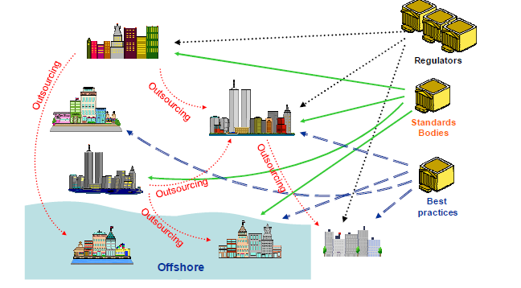
Compliance challenges for dynamic Enterprise collaboration
secure and trustworthy collaboration
organization’s regulatory compliance across a chain of composed services
Classic outsourcing becomes iterative and dynamic
Increased use of dynamically composed services
Contractual relationships change quickly and frequently
Different regulations and legal framework may apply
Lack of visibility and control

Slide 3
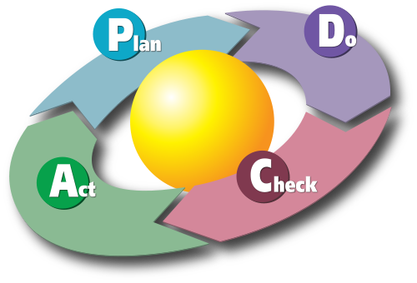
The MASTER solution
Management of regulatory compliance
Security assurance for collaboration amongst enterprises
Compliance of business processes across trust domains
Compliance governance engine aligned with Deming Cycle paradigm
Models, concepts, technology
SOA-based technical architecture
Design
Enforcement
Monitoring
Assessment
Control Process
Risk Analysis
Metrics
KAI (Key Assurance Indicator)
KSI (Key Security Indicator)
Source: Karn-b [http://karnbulsuk.blogspot.com/]

Slide 4
The MASTER design problem
Model-based transformation of high-level compliance requirements into executable policies that enable enforcement and assessment mechanisms
MASTER Methodology
Methodological support to specify MASTER compliance policies: monitoring, enforcement and assessment
Based on the Deming Cycle phases with emphasis on three pillars
Controls
Risk
Indicators
MASTER Design Workbench
Specification of high level policies (including regulations, standards, internal policy, etc...) in a structured form
Business Context Model
Protection & Assessment Model
Generation of policies that will configure the MASTER supporting infrastructure

Slide 5
MASTER Design process
Analyse the Business Context
Processes, services, resources, organization hierarchy
Establish Control Objectives and KAIs
Based on results of Risk Assessment
Control Objective Refinement
Establish Control Activities
Security best practices, ISO 27002, etc
Design Control Processes and KSIs
Repository of models for security/regulatory best practices: PRMs
Verify the Design of Control Processes
Implement Control Processes and Indicators
Define monitoring, enforcement and assessment mechanisms
Generate MASTER policies

Slide 6
MASTER Design workbench
Target (business) process, services and infrastructure
Regulations and codes of practice
Threat scenarios
Corporate policies and governance culture
Control
Objectives
Indicators
Design Model
Verification
Model
Design process
Control Activities
Evidence Model
Policy Model
Control Processes
Business Process
MASTER Policy

Slide 7
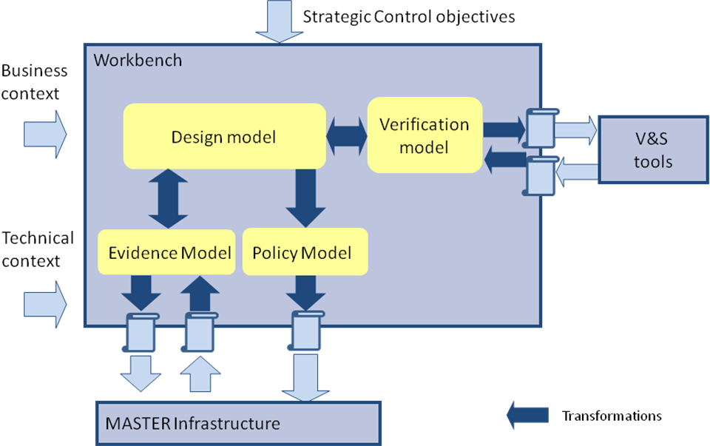
Model transformations

Slide 8
Questions?
Thank you!
Contact
Beatriz Gallego-Nicasio Crespo
Atos Research & Innovation (ARI)
Atos Origin, Spain
beatriz.gallego-nicasio@atosorigin.com
http://www.master-fp7.eu

